Slide 1
Topic: Data EQ: What does ‘Time Series’ mean?

Slide 2
Learning Objective
To use previous knowledge of bivariate data and line of best fit to find cycles, trends or patterns in data.

Slide 3
Success Criteria
I can identify a pattern in data.
I can identify a cycle or trend in data.
I can reason and predict a future value based on what I have identified.

Slide 4
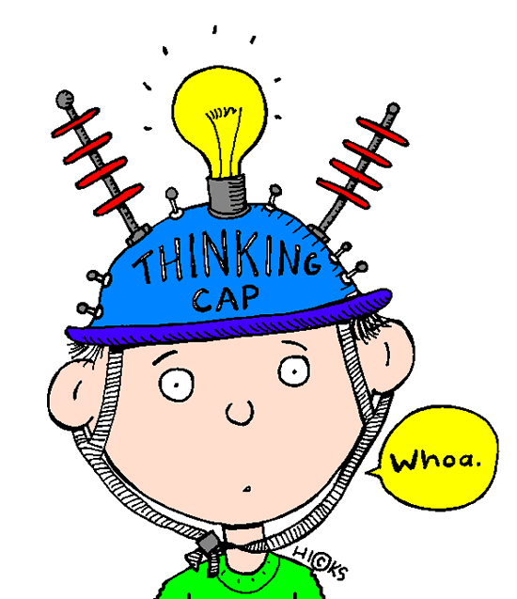
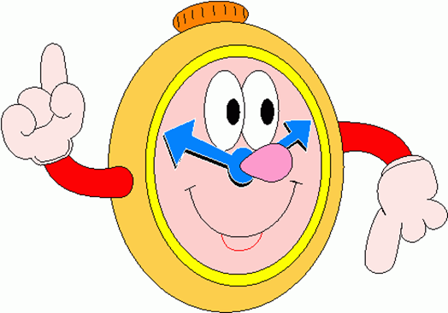
Quickwrite
What do you remember about extrapolation and interpolation?
2 minutes

Slide 5
24
7
30
Date
Topic: Data
EQ: What does ‘Time Series’ mean?
To help your revision…
What should your question be?
And again…
And again…
An ordered series of values of a variable taken at equally spaced time intervals
Forcasts possible outcomes using historical data, patterns or trends. EXTRAPOLATION so is not always totally accurate.
Trend analysis, cyclical fluctuations and seasonal data analysis.
*really important ATAR students so commit this to memory!!!!

Slide 6
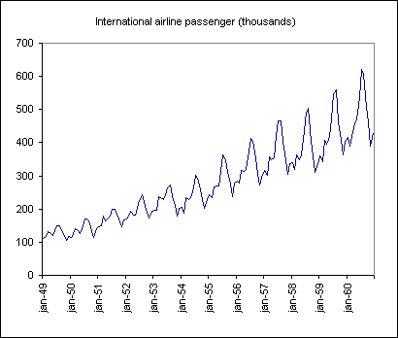
24
7
30
Date
Topic: Data
EQ: What does ‘Time Series’ mean?
To help your revision…
What should your question be?
Overall positive trend.
Each of these is a cycle

Slide 7

Task
Complete the questions from pages 250 and 251 in the Dwyer textbook.

Slide 8
Learning Objective
To use previous knowledge of bivariate data and line of best fit to find cycles, trends or patterns in data.

Slide 9
Success Criteria
I can identify a pattern in data.
I can identify a cycle or trend in data.
I can reason and predict a future value based on what I have identified.

Slide 10
Notes Review
24, 7 ,30
Date
Title
Essential question
Notes complete
Notes complete with colour and diagrams
Questions completed
Contents page filled in
Formula page filled in

Slide 11
Homework
Review your notes and write a summary answering the essential question.

